Slide 1
Lecture 4: Collective Phenomena

Slide 2
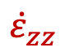
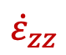
Collective phenomena
$${\dot{ε}}_{zz}$$
A notched bcc Fe single-crystal is subjected to a high rate of tensile deformation.
cross section
$${\dot{ε}}_{zz}$$

Slide 3
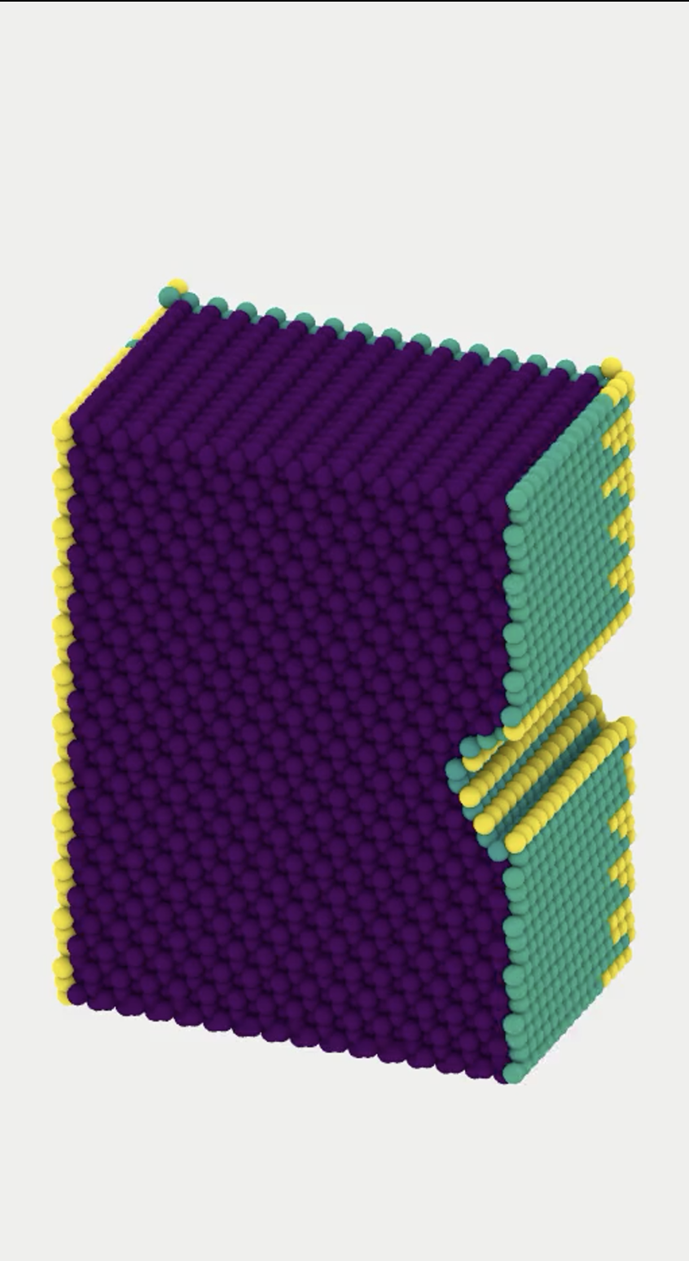
Collective phenomena
$${\dot{ε}}_{zz}$$
A notched bcc Fe single-crystal is subjected to a high rate of tensile deformation.
cross section
$${\dot{ε}}_{zz}$$

Slide 4
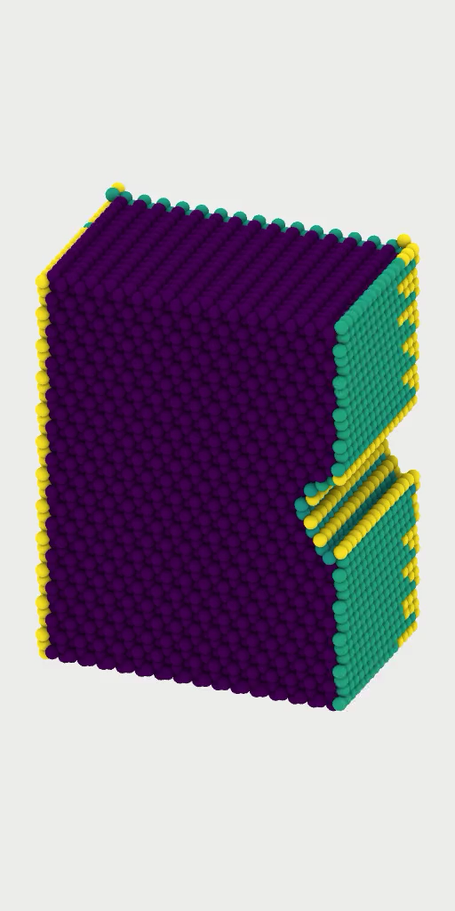
Collective phenomena
A notched bcc Fe single-crystal is subjected to a high rate of tensile deformation.
stress (GPa)
2.0
1.5
1.0
0.5
1.2 x
1.4 x
1.6 x
elongation

Slide 5
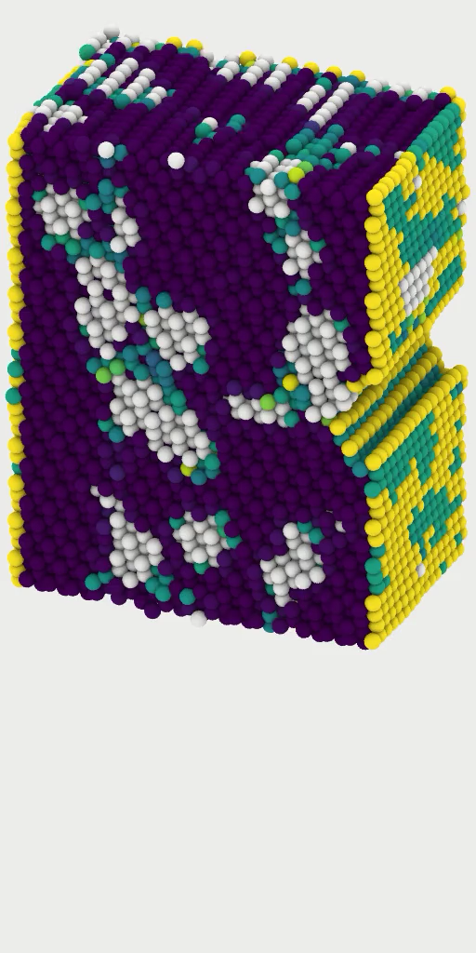
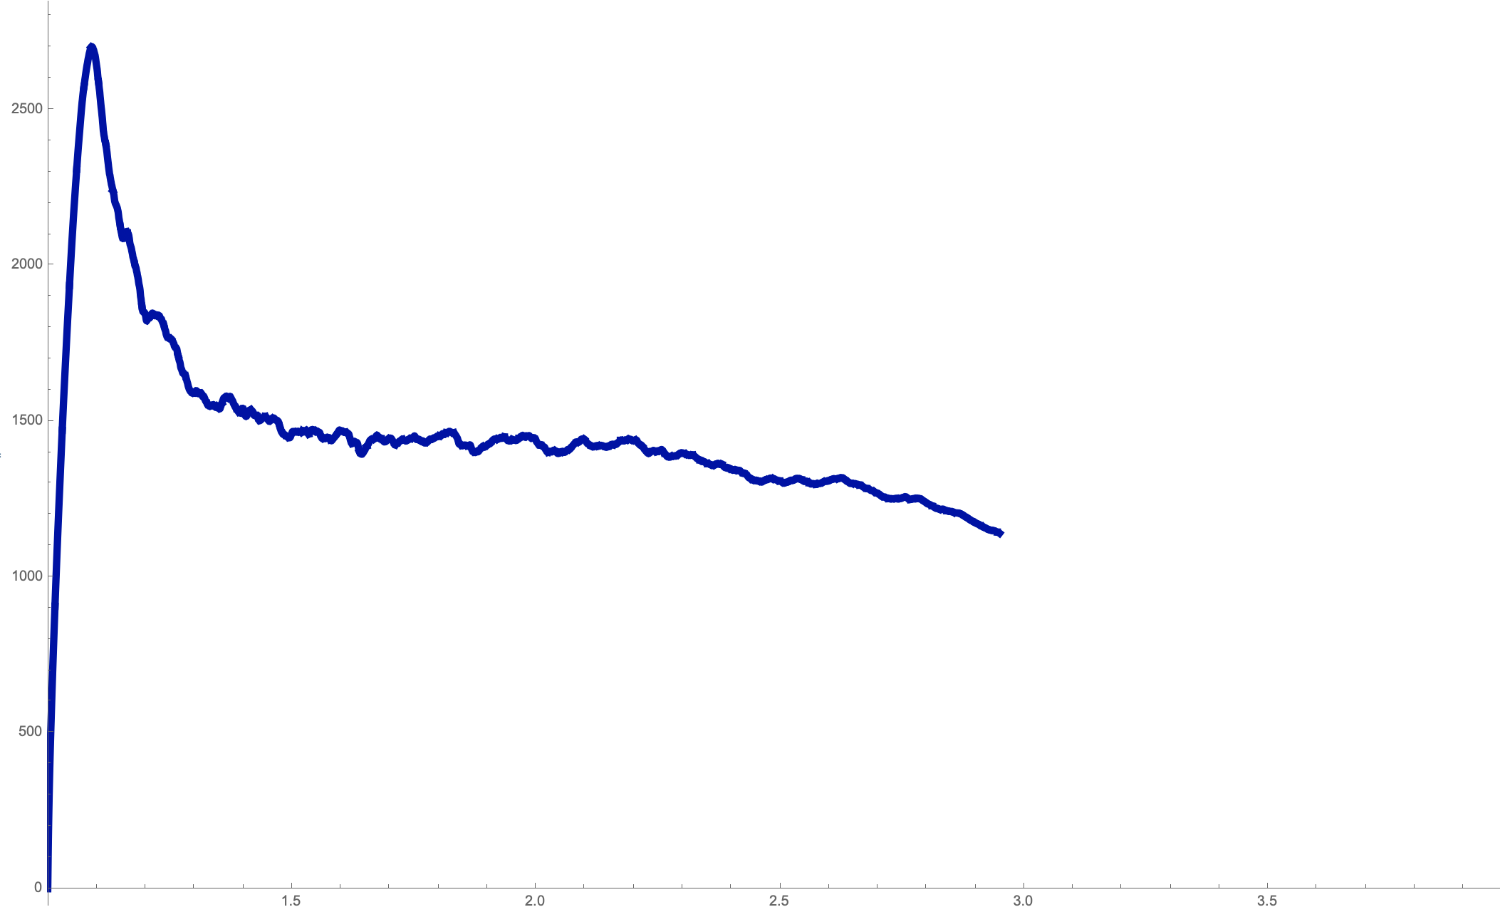
Collective phenomena
A notched bcc Fe single-crystal containing bcc W inclusions is subjected to a high rate of tensile deformation.
stress (GPa)
2.5
2.0
1.5
1.0
0.5
1.5 x
2.0 x
2.5 x
3.0 x
W inclusions
elongation

Slide 6
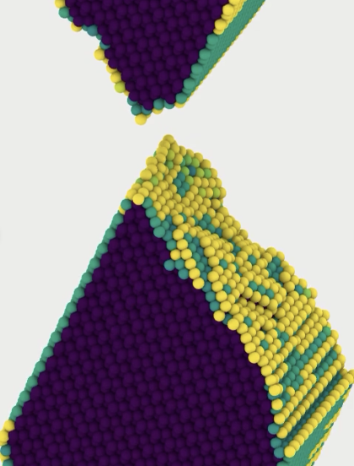
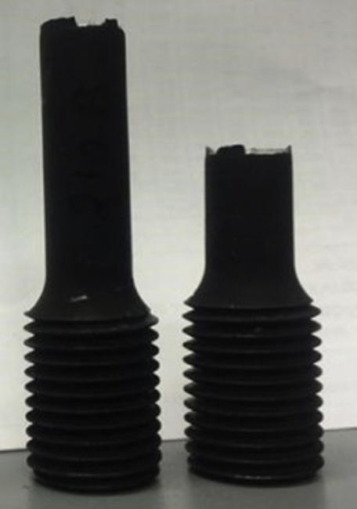
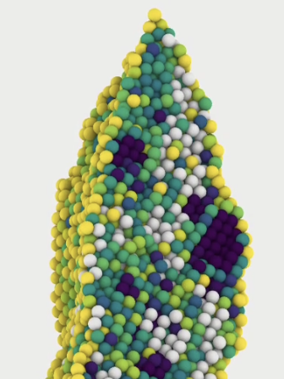
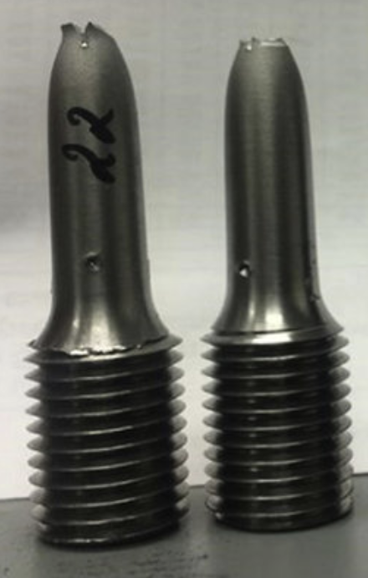
Collective phenomena
The mechanical properties of a component are dependent on its microstructure.
For example, depending on its content of dislocations, precipitates, point defects, grains, etc., the same material can behave brittle or ductile.
brittle fracture
ductile fracture
stress (GPa)
The defect-free crystal failed without
necking at the points of fracture
The crystal with W-inclusions failed after significant necking
2.5
2.0
1.5
ductile
1.0
0.5
brittle
no change in cross-section
change in cross-section
1.5 x
2.0 x
2.5 x
3.0 x
elongation
J. Glassman et al. (2020). Constr. Steel Res. 165

Slide 7
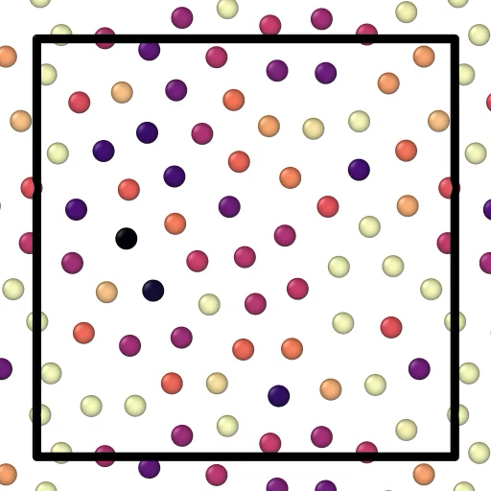
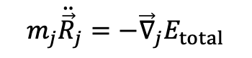
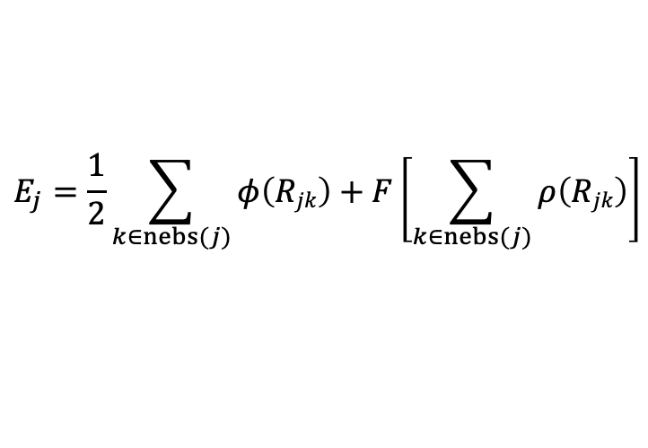
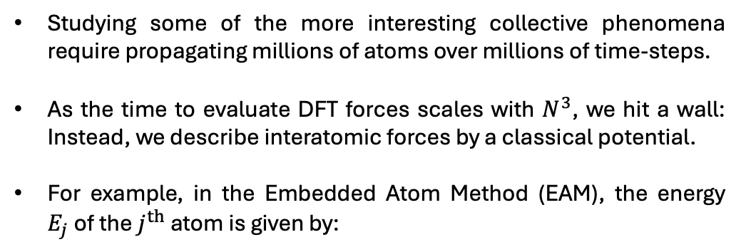
Molecular dynamics
Assuming atoms move slowly and electrons do not get excited (i.e. we remain in the ground-state adiabatically), we can propagate atomic trajectories following Newton’s equation of motion:
R_{jk}
R_{cutoff}
Right: Interatomic forces are short-ranged; a given atom j is only affected by the forces of atoms k within a range of R_{cutoff}.
atom k
atom j
$$m_{j}{\ddot{\vec{R}}}_{j}=−{\vec{∇}}_{j}E_{total}$$
a typical time-step is of order 1 fs = 10⁻¹⁵s
nebs(j)
Studying some of the more interesting collective phenomena require propagating millions of atoms over millions of time-steps.
As the time to evaluate DFT forces scales with $N^{3}$, we hit a wall: Instead, we describe interatomic forces by a classical potential.
For example, in the Embedded Atom Method (EAM), the energy $E_{j}$of the $j^{th}$ atom is given by:
out of range atoms
Right: An initially dis-ordered configuration of tungsten is quenched over 10 picoseconds.
Atoms are coloured by their potential energy.
$$E_{j}=\frac{1}{2}\sum_{k∈nebs(j)}{φ\left(Rjk\right)}+F\left[\sum_{k∈nebs(j)}{ρ\left(Rjk\right)}\right]$$
pairwise
short-ranged
many-body
short-ranged
M. W. Finnis and J. E. Sinclair (1984), Phil. Mag A 50.1: 45-55

Slide 8
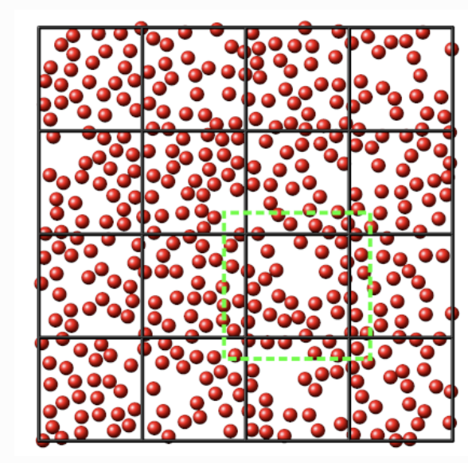
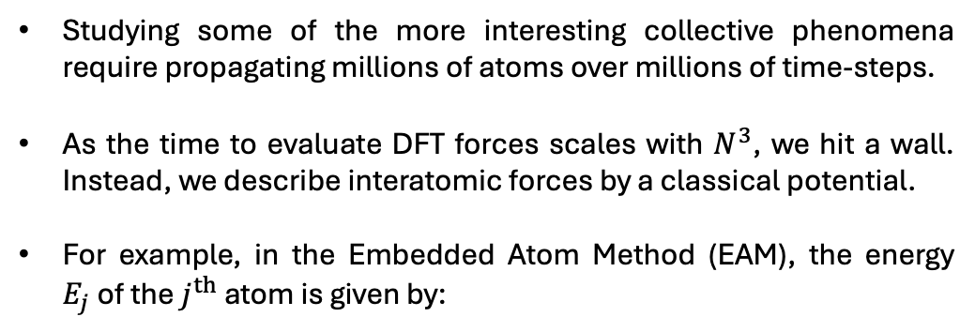
Molecular dynamics
Assuming atoms move slowly and electrons do not get excited (i.e. we remain in the ground-state adiabatically), we can propagate atomic trajectories following Newton’s equation of motion:
R_{jk}
R_{cutoff}
Right: Interatomic forces are short-ranged; a given atom j is only affected by the forces of atoms k within a range of R_{cutoff}.
atom k
atom j
$$m_{j}{\ddot{\vec{R}}}_{j}=−{\vec{∇}}_{j}E_{total}$$
a typical time-step is of order 1 fs = 10⁻¹⁵s
nebs(j)
Studying some of the more interesting collective phenomena require propagating millions of atoms over millions of time-steps.
As the time to evaluate DFT forces scales with $N^{3}$, we hit a wall. Instead, we describe interatomic forces by a classical potential.
For example, in the Embedded Atom Method (EAM), the energy $E_{j}$of the $j^{th}$ atom is given by:
out of range atoms
Right: MD parallelisation illustrated for 16 CPUs: the simulation cell is split into a domains, one per CPU. Each CPU only evaluates forces in its own domain.
CPU 1
CPU 2
CPU 3
CPU 4
CPU 5
CPU 6
CPU 7
CPU 8
$$E_{j}=\frac{1}{2}\sum_{k∈nebs(j)}{φ\left(Rjk\right)}+F\left[\sum_{k∈nebs(j)}{ρ\left(Rjk\right)}\right]$$
CPU 9
CPU 10
CPU 11
CPU 12
pairwise
short-ranged
many-body
short-ranged
CPU 13
CPU 14
CPU 15
CPU 16
M. W. Finnis and J. E. Sinclair (1984), Phil. Mag A 50.1: 45-55

Slide 9
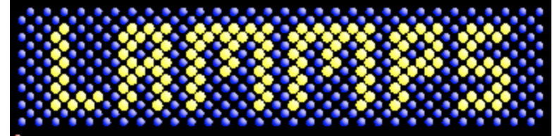
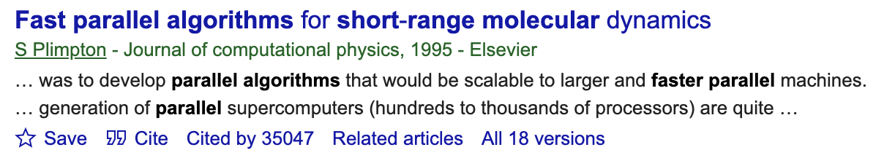
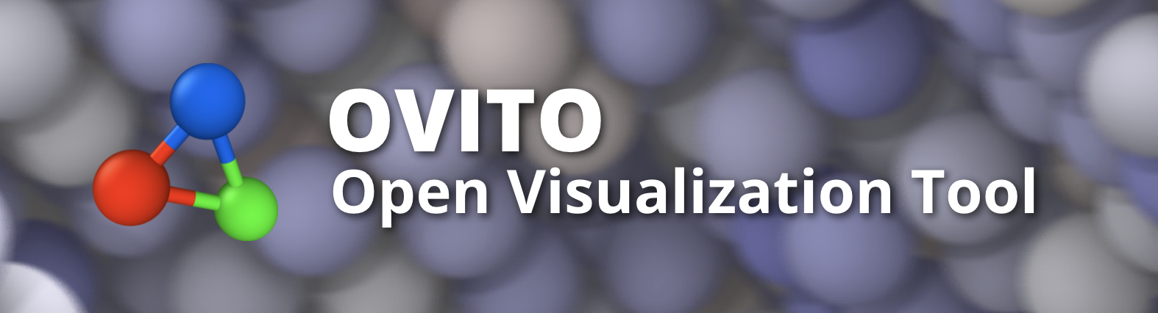

Molecular dynamics
LAMMPS Molecular Dynamics Simulator
R_{cutoff}
Free, open source, highly scalable on CPUs & GPUs
Right: Interatomic forces are short-ranged; a given atom j is only affected by the forces of atoms k within a range of R_{cutoff}.
R_{jk}
atom k
atom j
nebs(j)
out of range atoms
Analysis and visualisation: OVITO
Right: MD parallelisation illustrated for 16 CPUs: the simulation cell is split into a domains, one per CPU. Each CPU only evaluates forces in its own domain.
CPU 1
CPU 2
CPU 3
CPU 4
CPU 5
CPU 6
CPU 7
CPU 8
CPU 9
CPU 10
CPU 11
CPU 12
CPU 13
CPU 14
CPU 15
CPU 16

Slide 10
Two examples of MD applied to fusion materials
neutron
flux
Deuterium-Tritium fusion
(100 million Celsius)
²H
³H
n (14.1 MeV)
⁴He (3.5 MeV)

Slide 11
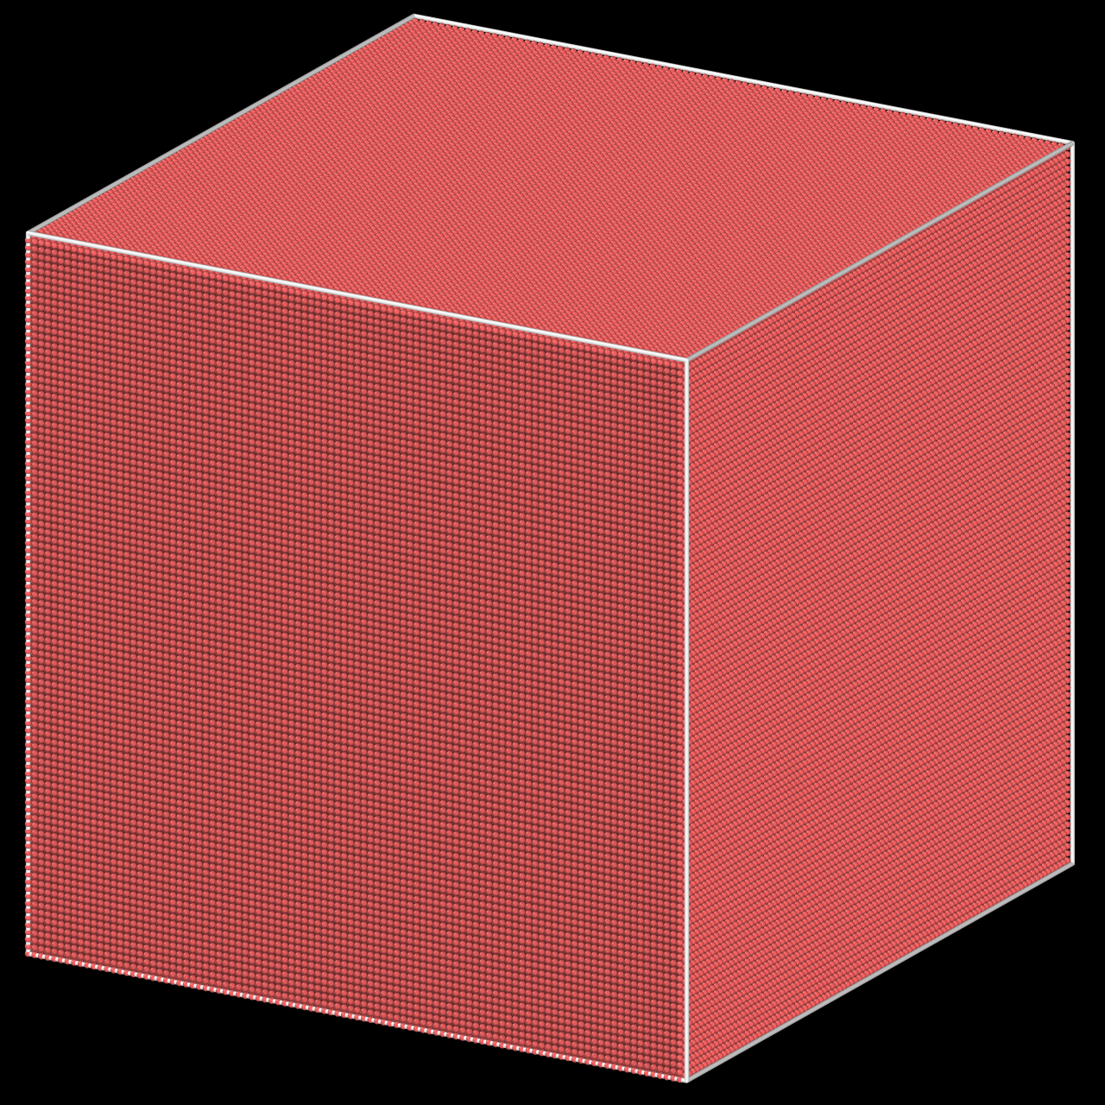
100 keV Collision Cascade in tungsten
32 nm
BCC unit cell
0.316 nm
(2 mio atoms)

Slide 12
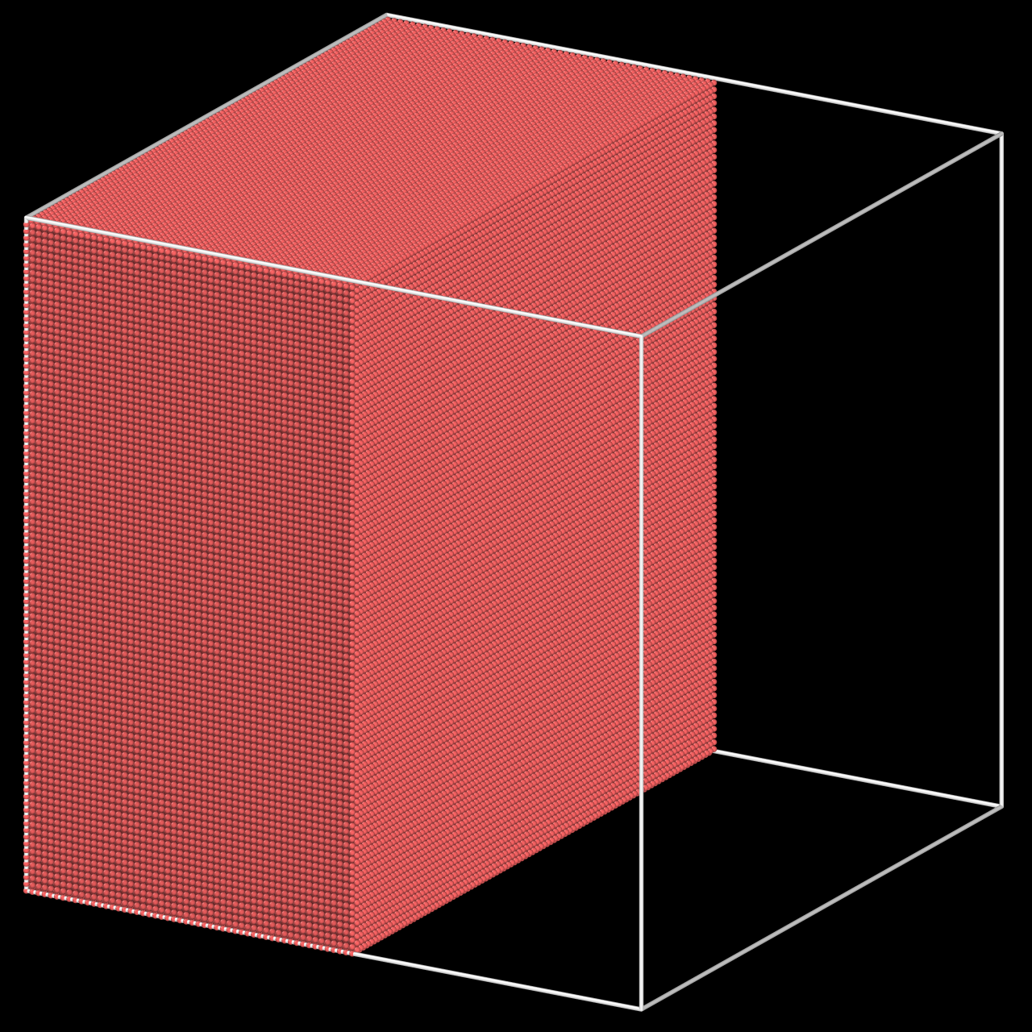
100 keV Collision Cascade in tungsten
32 nm
100 keV
BCC unit cell
0.316 nm
(2 mio atoms)

Slide 13
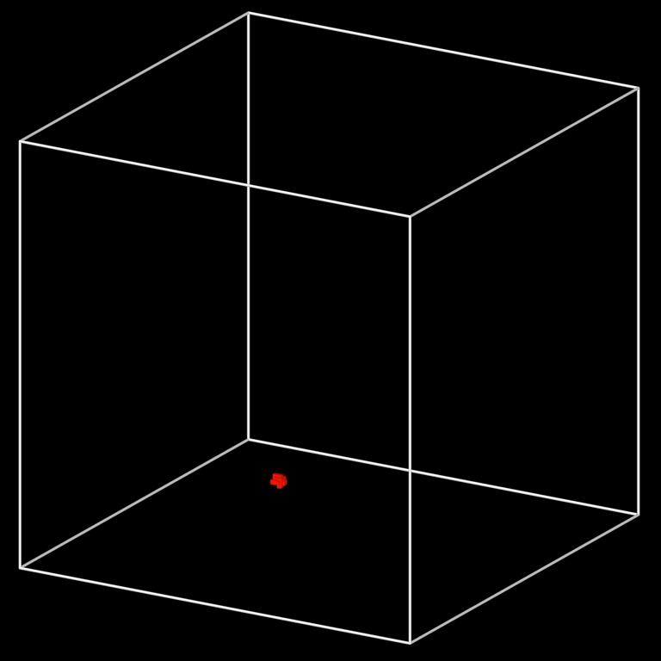


$φ=$0.0002 dpa
Pressure (GPa)
100
100 keV Collision Cascade in tungsten
10
0
-10
-100

Slide 14
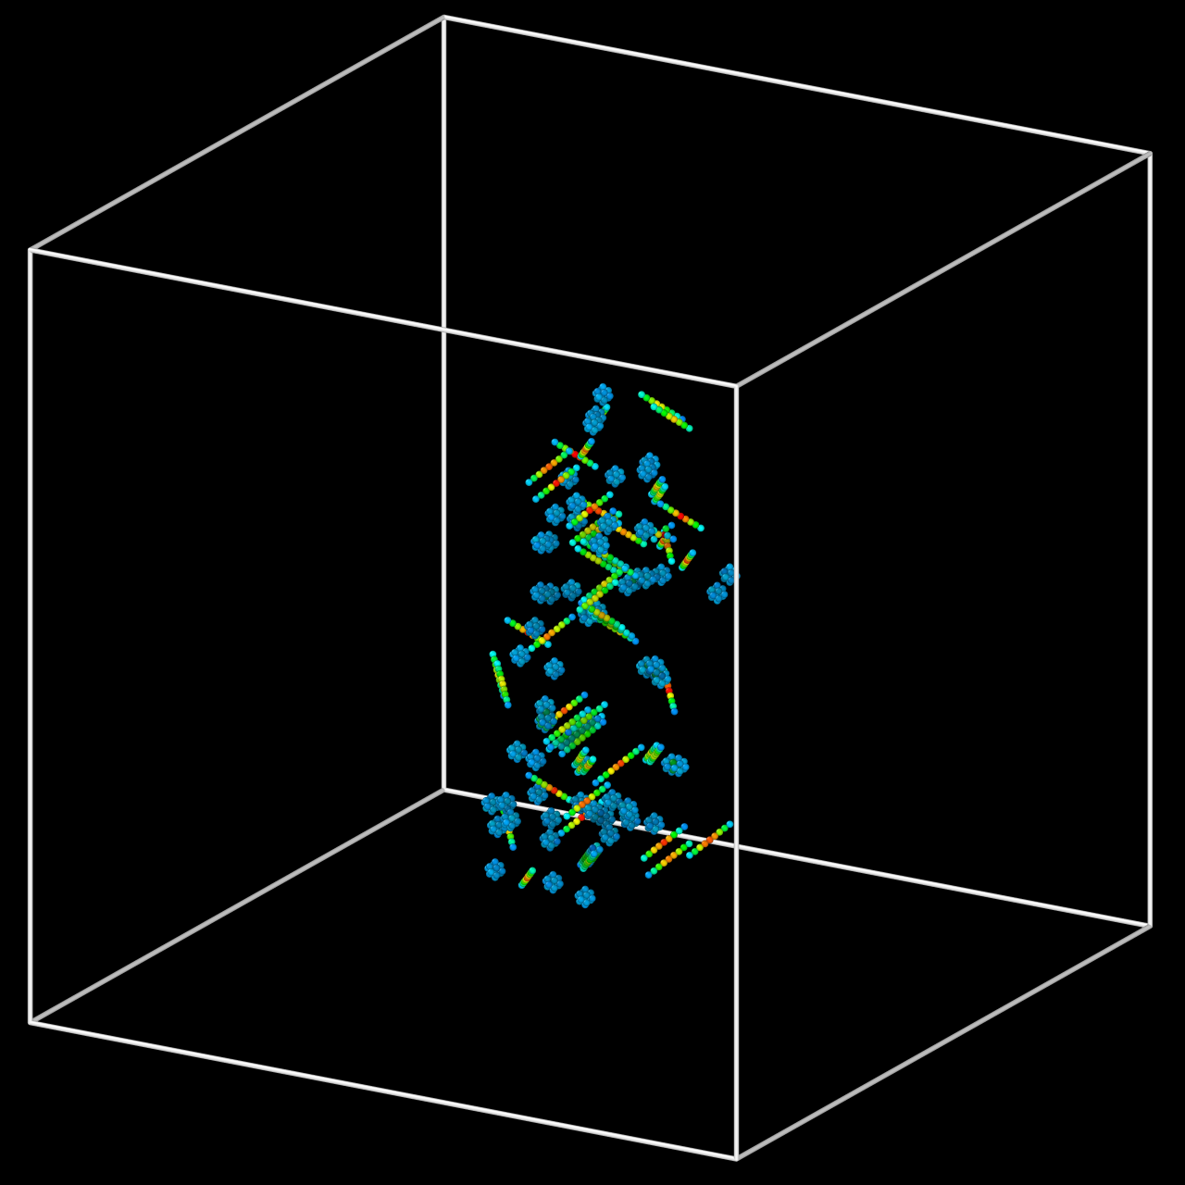

$φ=$0.0002 dpa
100 keV Collision Cascade in tungsten
excess potential energy (eV)
<111> cluster
1.6
crowdion
0.8
0
vacancy

Slide 15
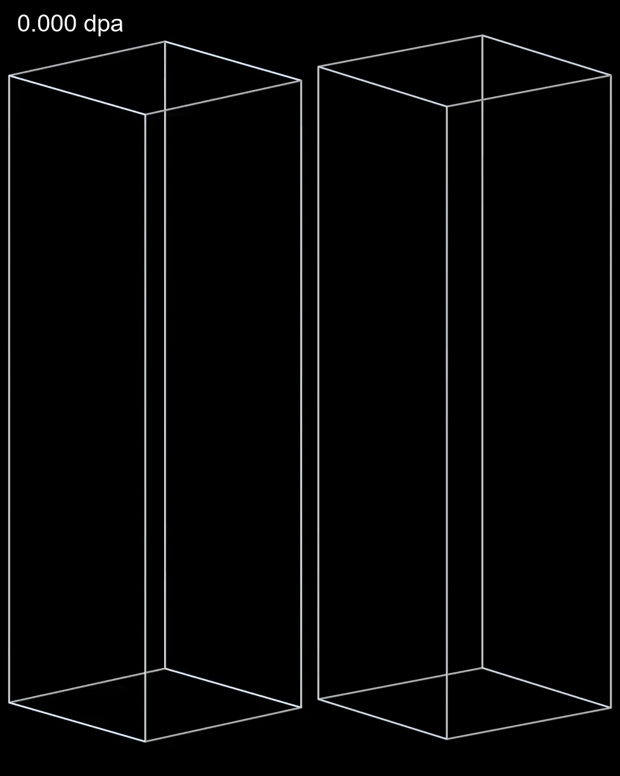


Mason et al. (2020) PRL 125.22: 225503
High-dose simulations require access to high performance computing facilities.
Computer time required to reach 1 dpa:
50,000 CPU-hours
i.e. ~1% of a typical HPC allocation
Simulated dose-rate:
Experimental dose-rate:
$\dot{φ}∼{10}^{7} dpa/s$
$$\dot{φ}∼{10}^{−7} dpa/s$$
14 orders of magnitude difference between simulated and exp. time!
interstitials
<111> dislocations
vacancies
<100> dislocations

Slide 16
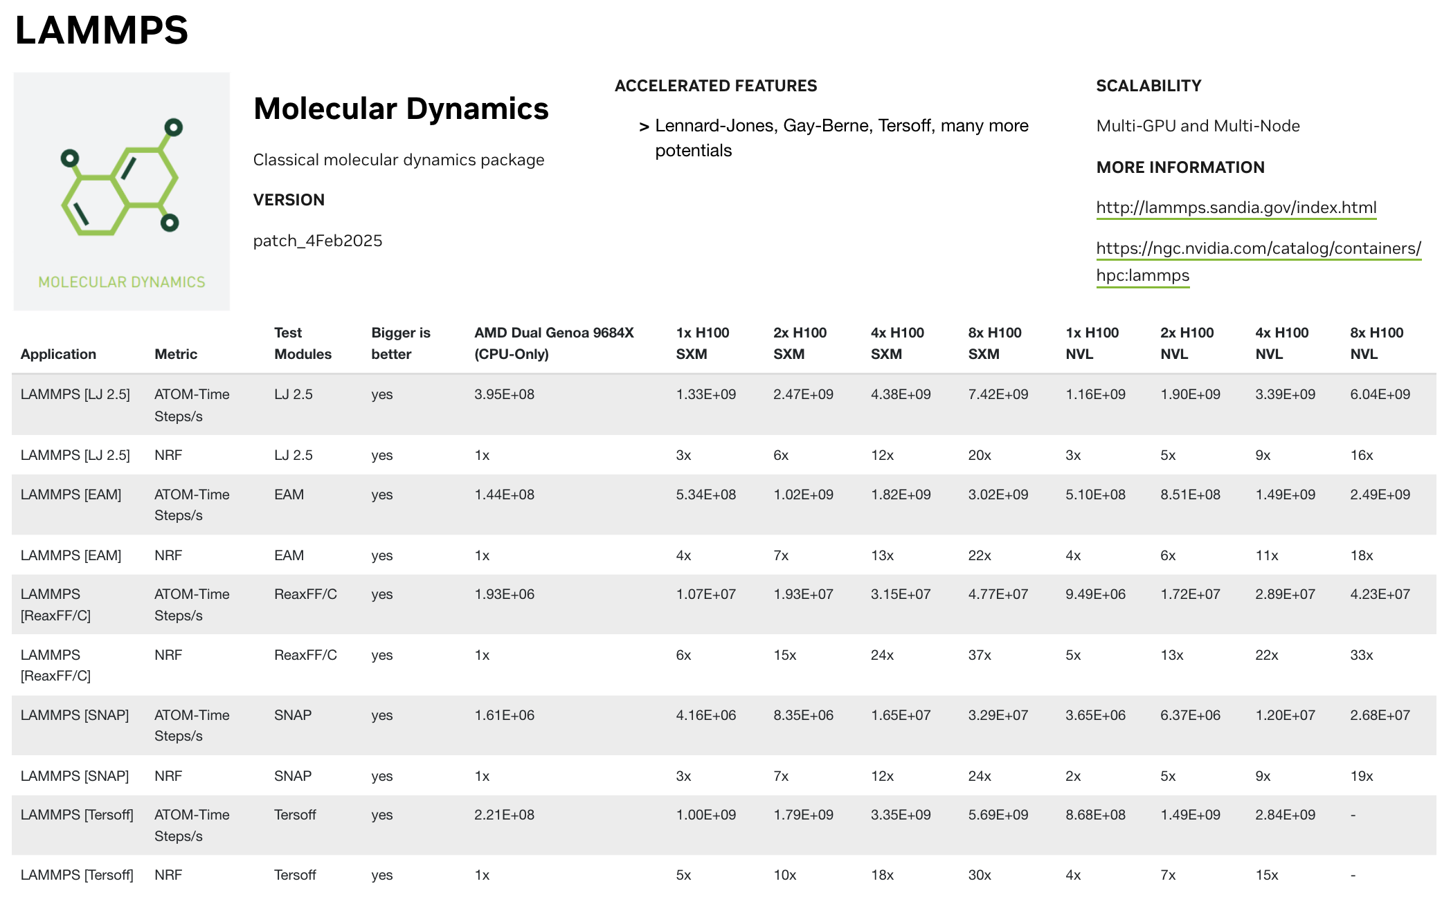
https://developer.nvidia.com/hpc-application-performance
toy potential
empirical potential
machine-learned

Slide 17
On the range of validity of high-dose simulations
Microstructure evolves on multiple starkly different timescales.
See simulated post-irradiation annealing of a W single-crystal (dose 0.32dpa, ramping rate 2.5 x 10¹¹ K/s)
Most recovery occurs at about 0.75eV, consistent with stage-III recovery
There is a large spectral gap from 0.10eV to 0.45eV; in between interstitials and vacancies becoming mobile, not much else happens
In conclusion, cascade simulations generate microstructures consistent with the earlier recovery stages
spectral gap
spectral gap
Boleininger et al. (2023) Sci. Rep. 13 (1): 1684

Slide 18
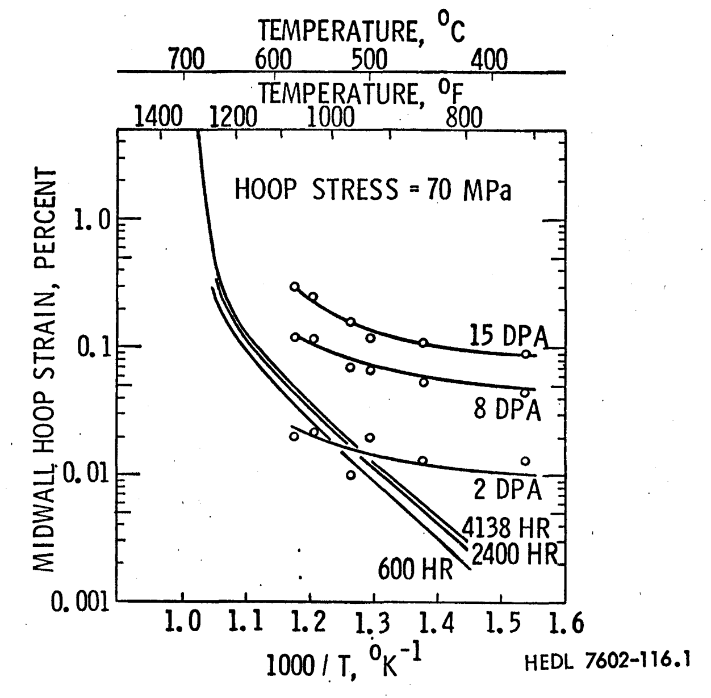
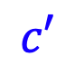
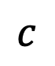
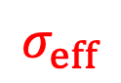
Low temperature irradiation creep
Irradiation is well known to enhance creep rates; conventional models creep rates increase with temperature.
Temperature (℃)
press. gas
time
in-vessel creep
fluence
What happens at lower temperature?
metal tube
Effective creep strain (%)
$$σ_{eff}$$
thermal
creep
$$c$$
$$c′$$
316 SS
1000/T (K⁻¹)
Creep in a He-pressurised tube in a test reactor is
measured by the change in circumference
Gilbert (1977), Measurement of Irradiation-enhanced Creep in Nuclear Materials, 204-209

Slide 19
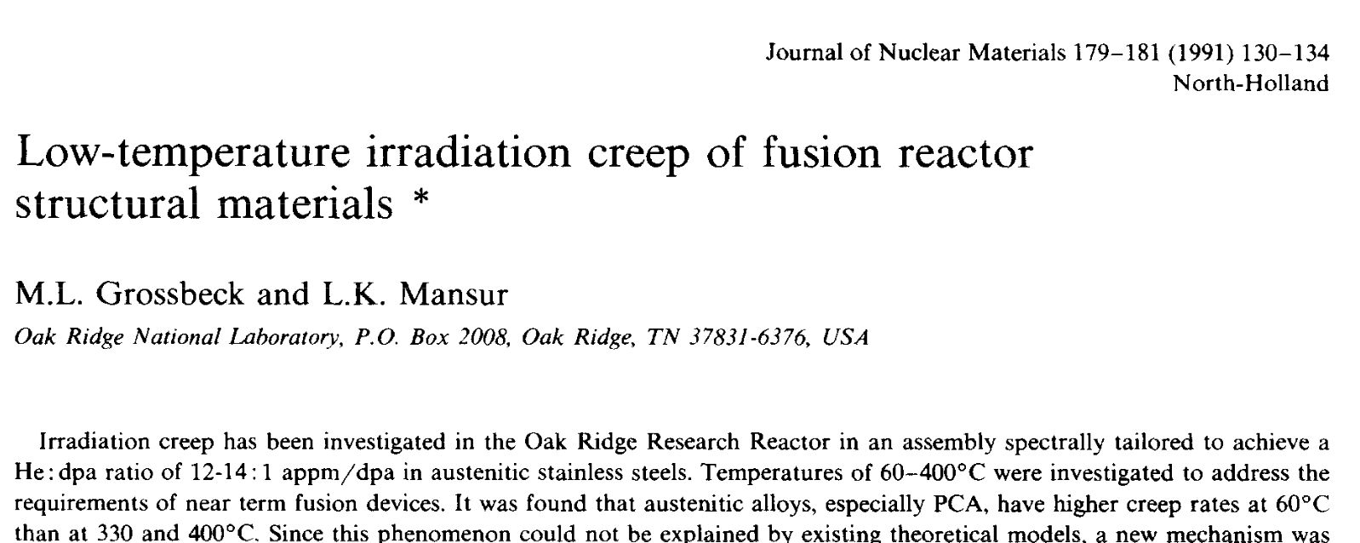
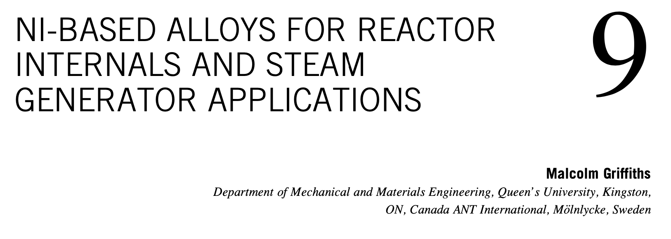
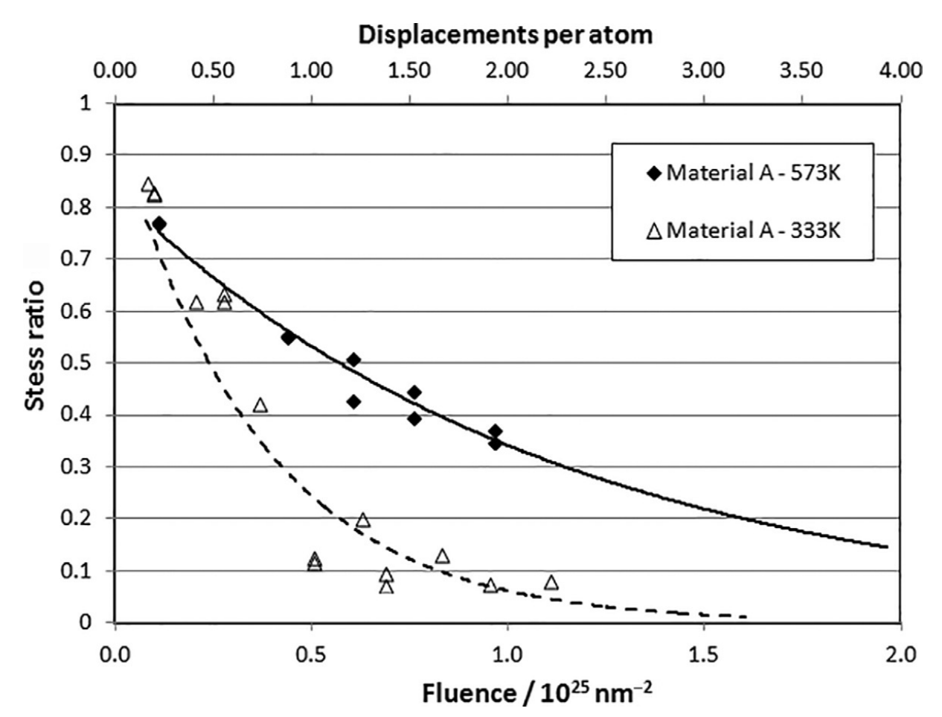
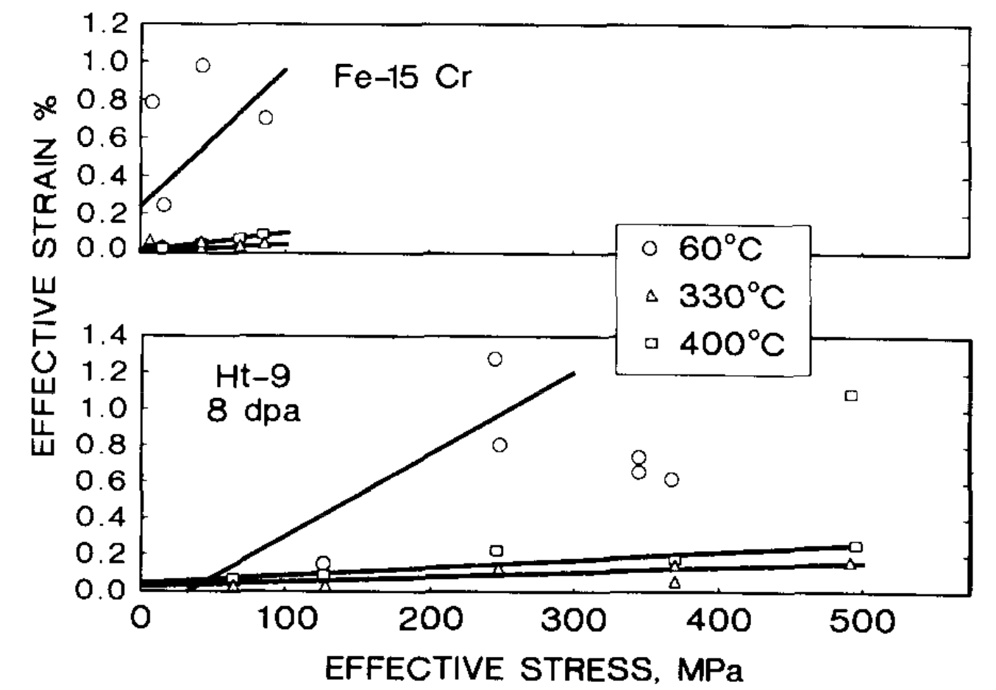
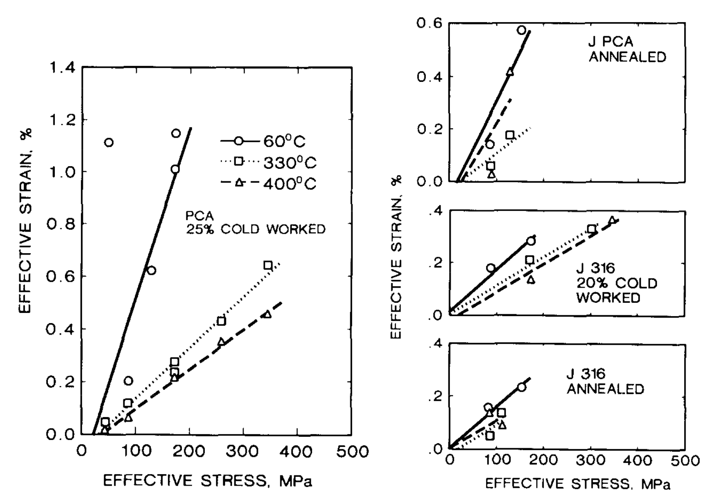
Griffiths (2019) Structural Alloys for Nuclear Energy Applications
Stress relaxation for Inconel-750X bent beams in NRU
Irradiation creep at 8 dpa in pressurised steel tubes, 60-125 appm He
60 ℃
300 ℃
60 ℃
330 ℃
400 ℃

Slide 20

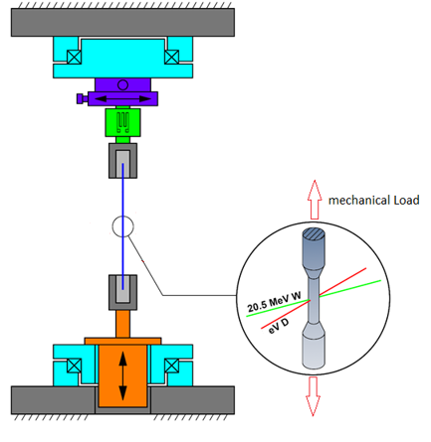
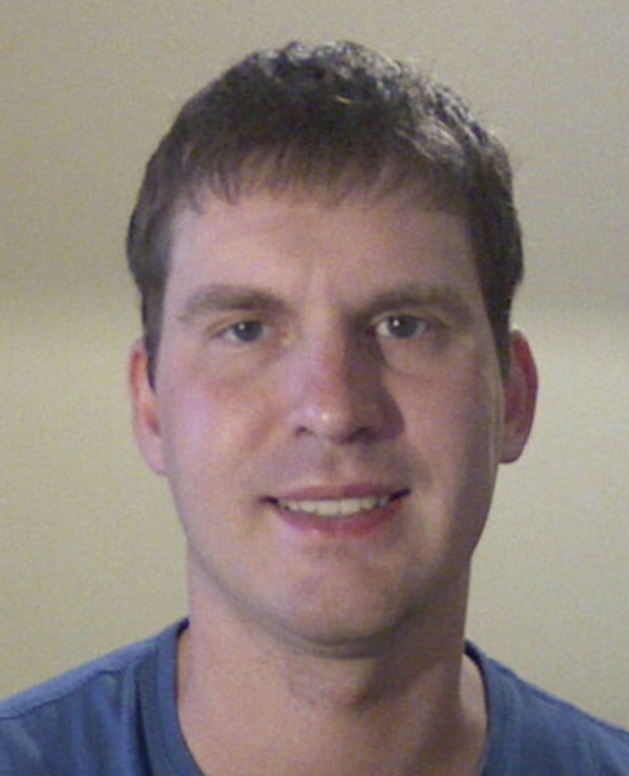


The GIRRAFE experiment
General-purpose irradiated fiber and foil experiment
Johann Riesch, Alexander Feichtmayer, and others, at IPP Garching
Cost-effective and surrogate for reactor conditions using high-energy ions from a particle accelerator under simultaneous loading by:
mechanical loading and tensile testing
cooling or heating
low energy deuterium or helium plasma
Rotary stage
mechanical load
Load cell
Sample
Alexander Feichtmayer,
PhD Candidate
Dr. Johann Riesch
20.5 MeV
W⁶⁺ ions
thin tungsten wire
Linear actuator
Rotary stage

Slide 21
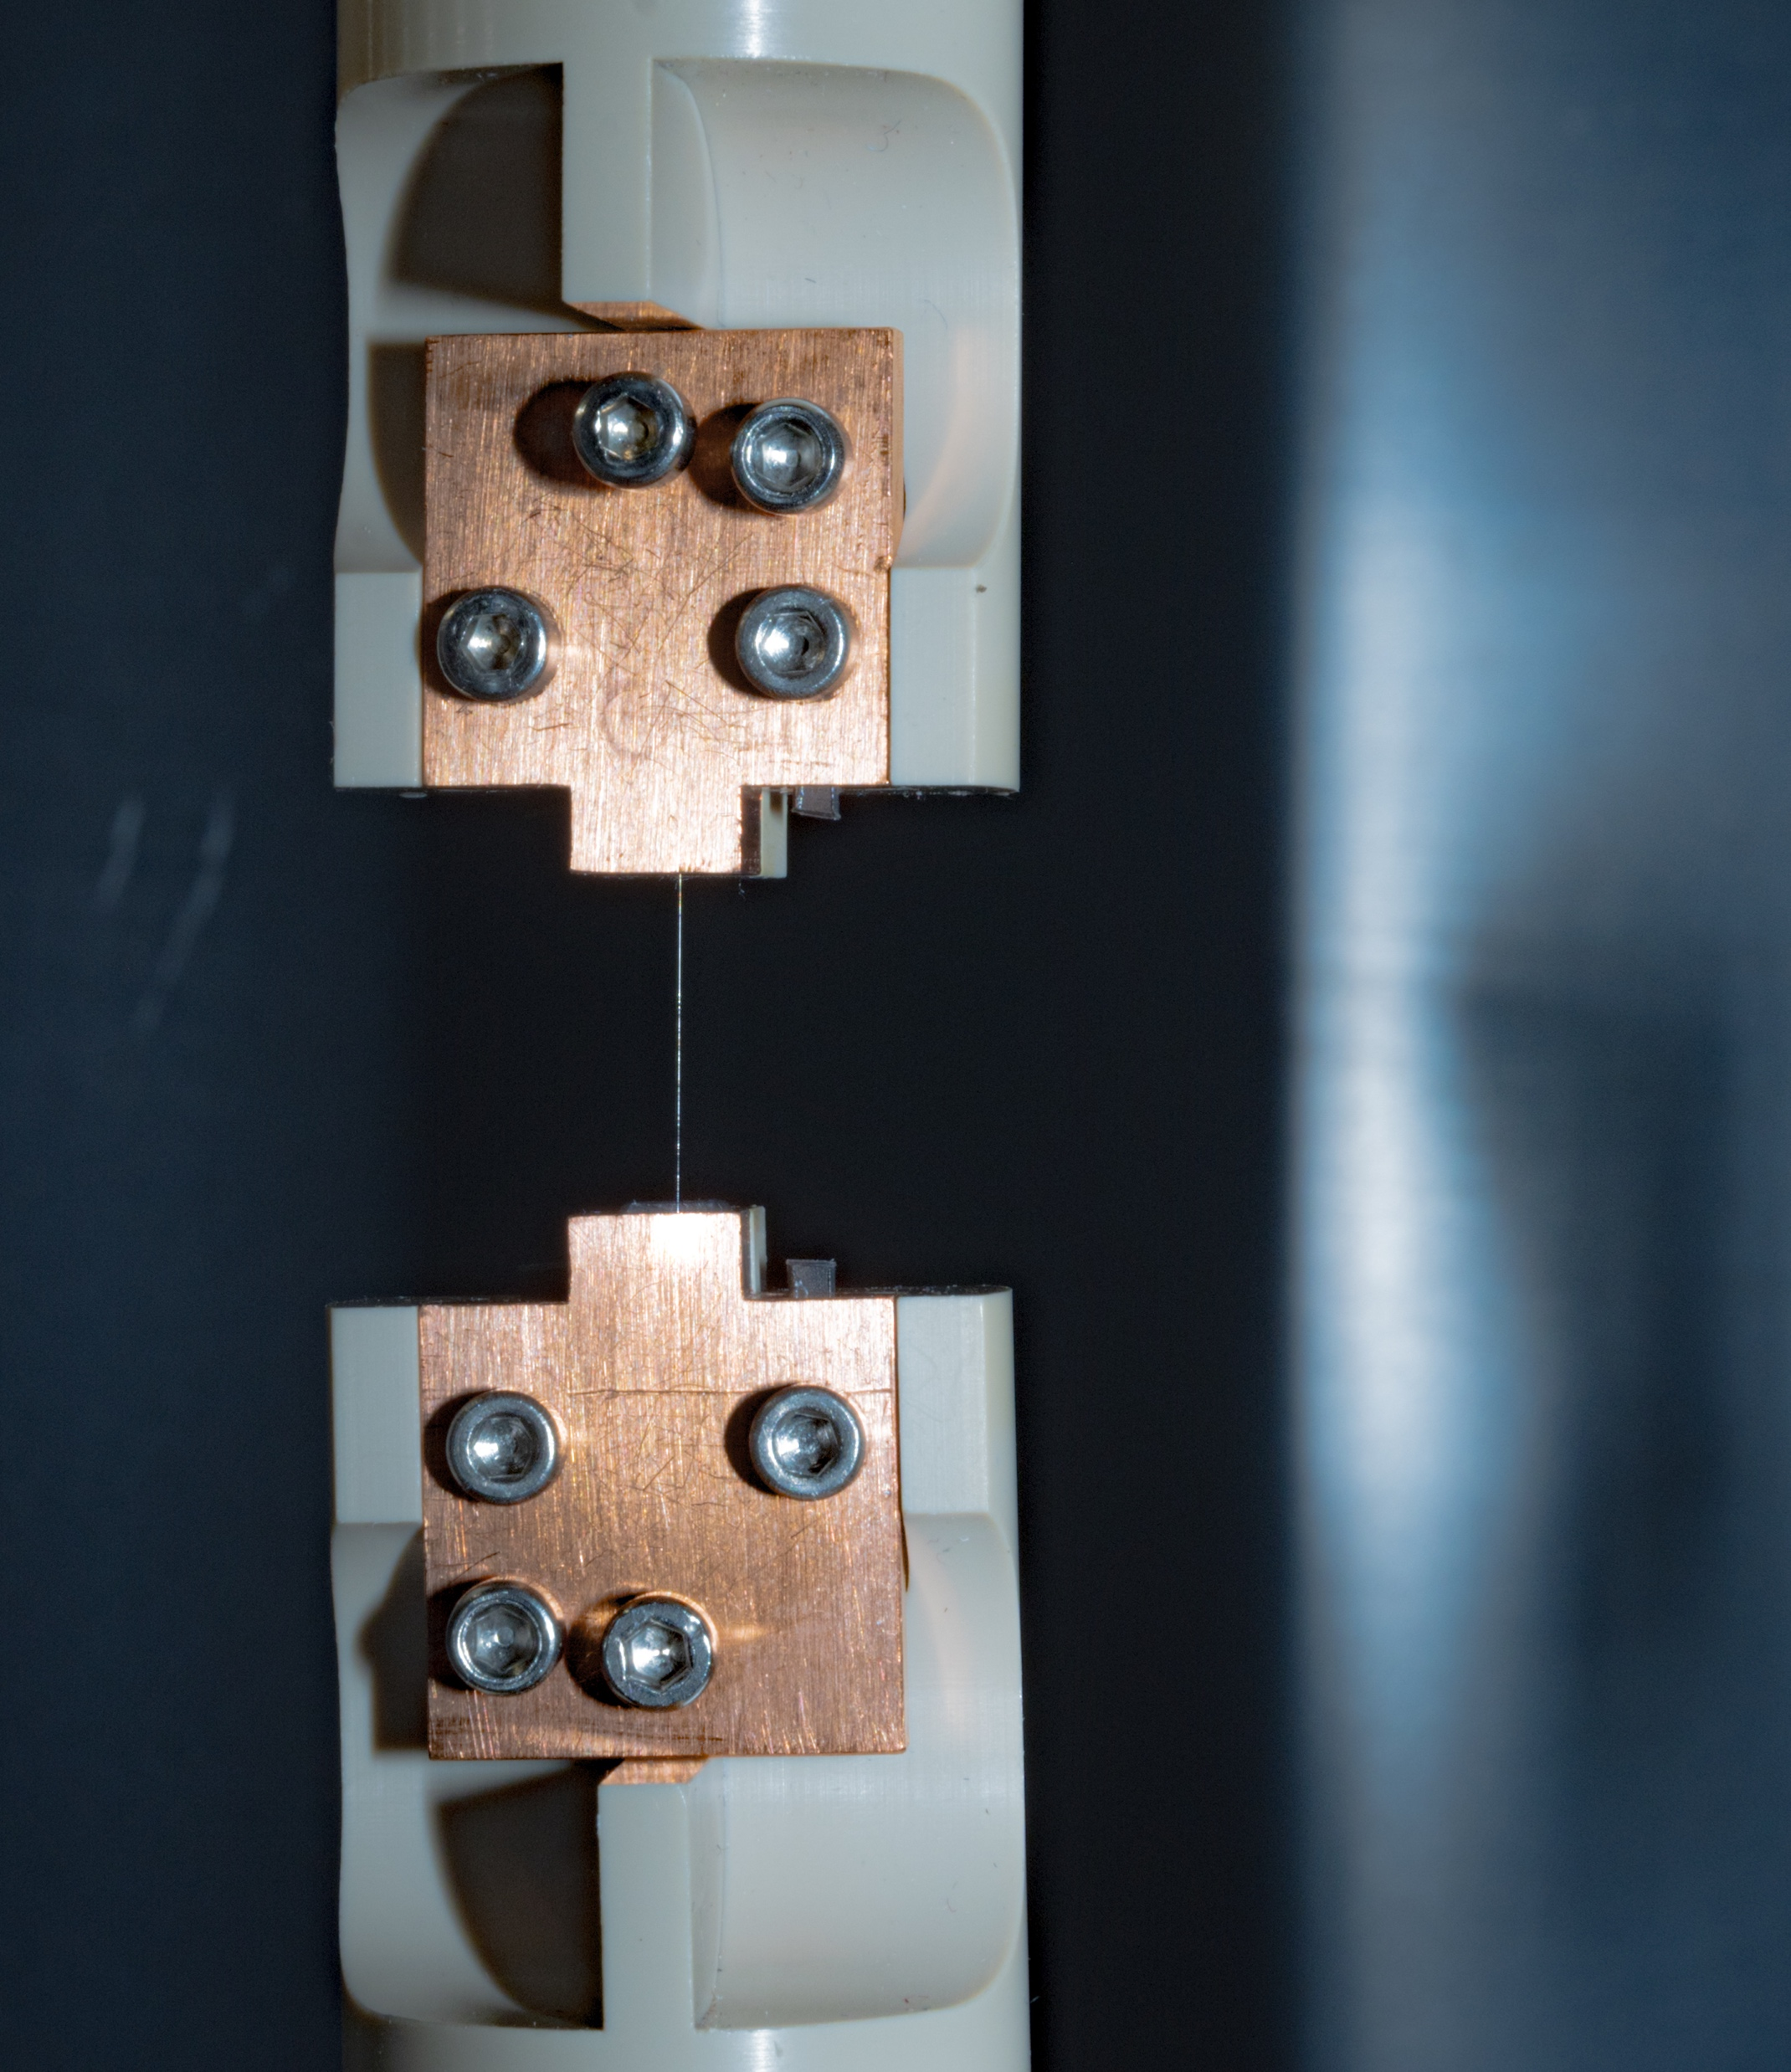
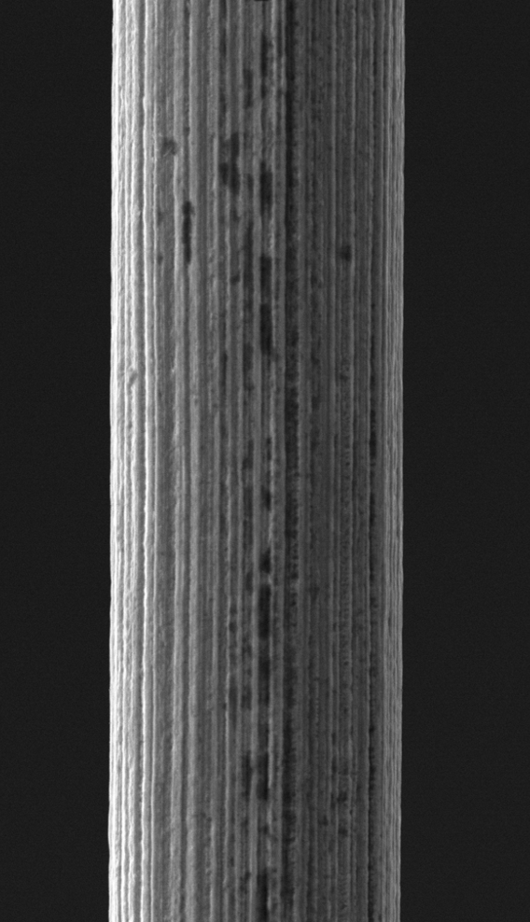
In-situ irradiation creep experiment
0 MPa
Credit: Robert Lürbke | IPP
16 µm
15 mm

Slide 22
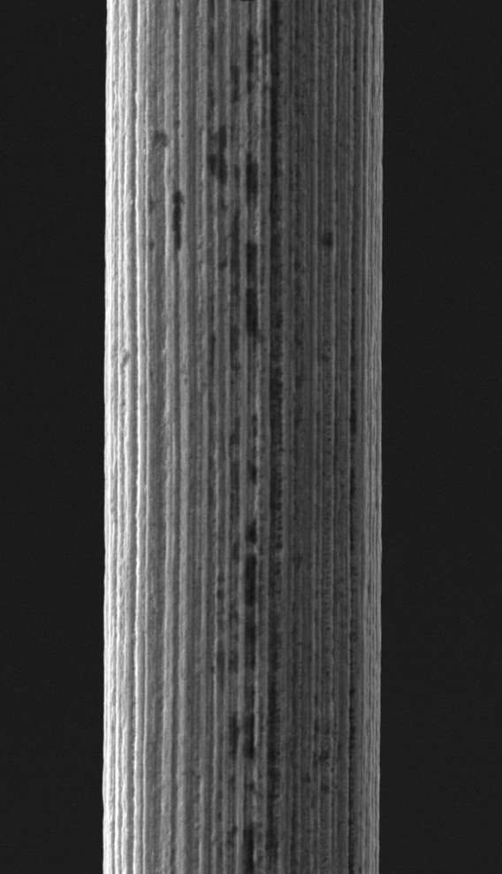
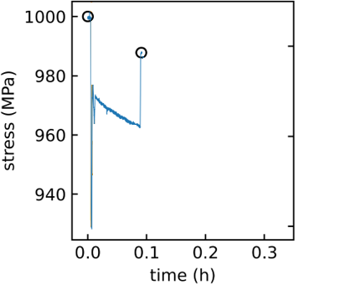
In-situ irradiation creep experiment
0 MPa
1000 MPa
Credit: Robert Lürbke | IPP
16 µm
15 mm

Slide 23
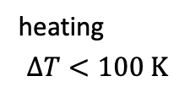
In-situ irradiation creep experiment
0 MPa
1000 MPa
970 MPa
Credit: Robert Lürbke | IPP
20.3 MeV W⁶⁺
heating
$$ΔT<100 K$$
16 µm
15 mm

Slide 24
In-situ irradiation creep experiment
0 MPa
1000 MPa
970 MPa
990 MPa
Credit: Robert Lürbke | IPP
20.3 MeV W⁶⁺
heating
$$ΔT<100 K$$
16 µm
15 mm

Slide 25
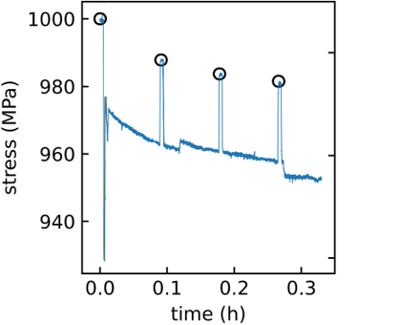
In-situ irradiation creep experiment
0 MPa
1000 MPa
970 MPa
990 MPa
Credit: Robert Lürbke | IPP
20.3 MeV W⁶⁺
heating
$$ΔT<100 K$$
16 µm
repeat
15 mm

Slide 26
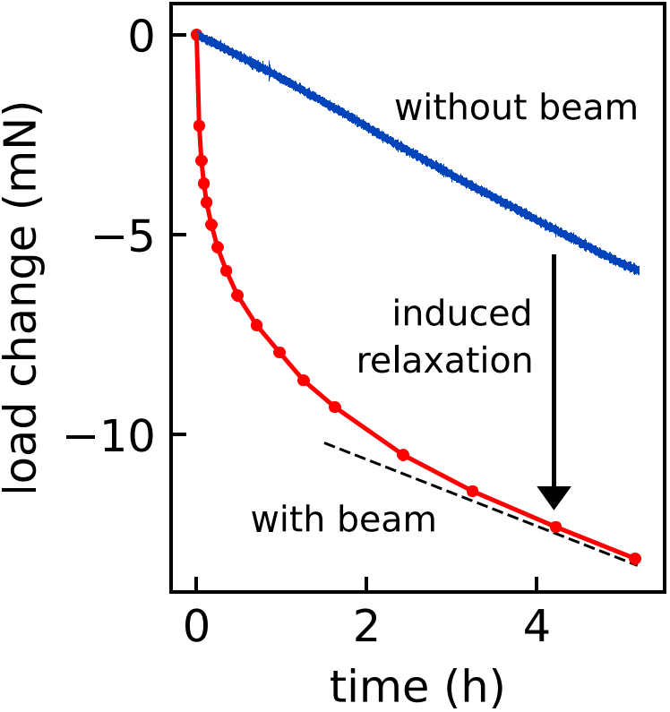
In-situ irradiation creep experiment
0 MPa
1000 MPa
970 MPa
990 MPa
Credit: Robert Lürbke | IPP
20.3 MeV W⁶⁺
heating
$$ΔT<100 K$$
16 µm
repeat
15 mm
6 dpa

Slide 27
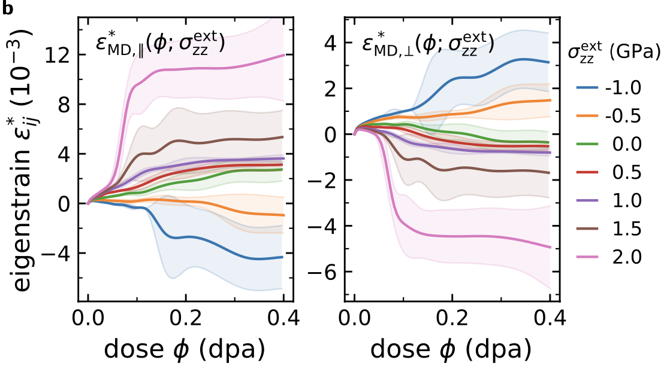
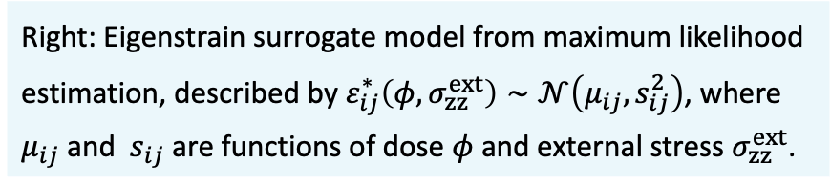
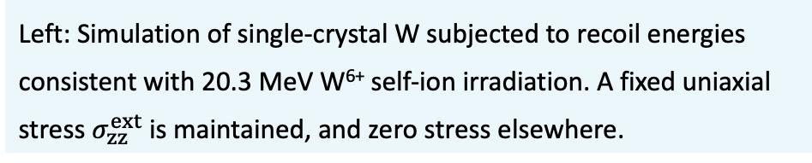
Surrogate model driven by molecular dynamics
We use MD as a “black box” model to generate the $ε^{∗}\left(φ,σ_{el}, p\left(E_{R}\right)\right)$ materials data:
For a given constant external stress $σ_{el}$, the surrogate model returns eigenstrain $ε^{∗}$ as a function of irradiation dose $φ$.
Left: Simulation of single-crystal W subjected to recoil energies consistent with 20.3 MeV W⁶⁺ self-ion irradiation. A fixed uniaxial stress $σ_{zz}^{ext}$ is maintained, and zero stress elsewhere.
Right: Eigenstrain surrogate model from maximum likelihood estimation, described by $ε_{ij}^{∗}\left(φ, σ_{zz}^{ext}\right)∼𝒩\left(μ_{ij}, s_{ij}^{2}\right)$, where $μ_{ij}$ and $s_{ij}$ are functions of dose $φ$ and external stress $σ_{zz}^{ext}$.
Boleininger et al. (2022) PRMat. 6 (6): 063601
Feichtmayer et al. (2024) Comm. Mater. 5.1: 218

Slide 28
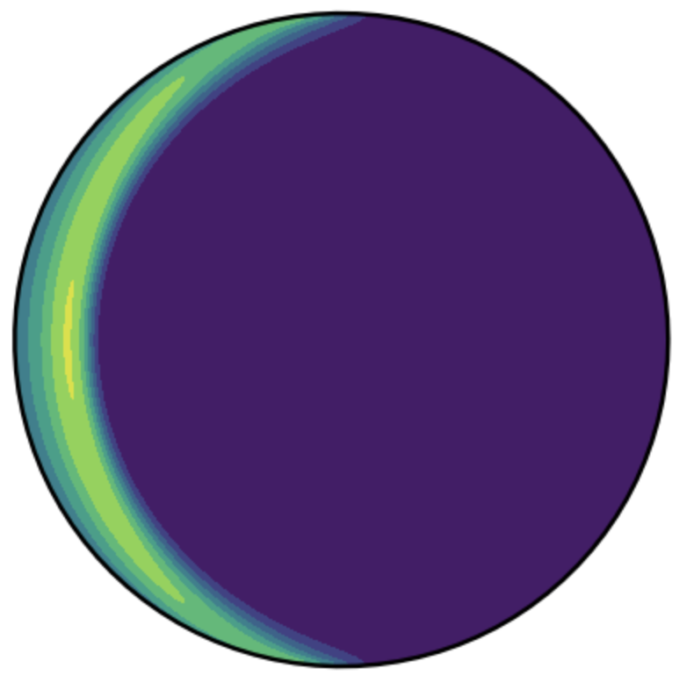


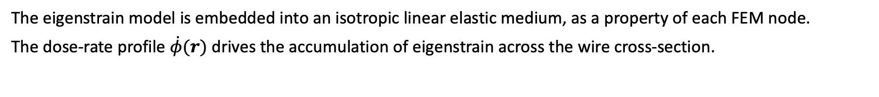
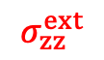
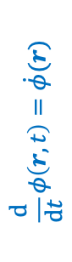




“Digital shadow:” multiscale irradiation creep model
The eigenstrain model is embedded into an isotropic linear elastic medium, as a property of each FEM node.
The dose-rate profile $\dot{φ}(r)$ drives the accumulation of eigenstrain across the wire cross-section.
1. The eigenstrain is expressed as a body-force:
Reali et al. (2021) Nucl. Fus. 61.1: 016002
Simulated exposure profile (SRIM)
$f^{∗}\left(r,t\right)=C :(∇⋅ε^{∗}\left(r,t\right))$
y
$\dot{φ}$ (dpa/h)
2. And embedded into linear elasticity:
1.2
$$\frac{d}{dt}φ\left(r,t\right)=\dot{φ}(r)$$
propagate time
$$∇⋅σ\left(r,t\right)=−f^{∗}(r,t)$$
$$σ\left(r,t\right)=σ^{elastic}\left(r,t\right)+C :(∇⋅ε^{∗}\left(r,t\right))$$
20.3 MeV
W⁶⁺ ions
x
0
3. Here, eigenstrain is assumed to accumulate irreversibly:
0 µm
8 µm
$${\frac{d}{dt}ε}^{∗}\left(r,t\right)={\frac{d}{dt}ε}_{MD}^{∗}[φ, σ^{elastic}]\left(r,t\right)$$
$$σ_{zz}^{ext}$$
The surrogate model does not account for the general stress history. We assume that eigenstrain accumulates irreversibly w.r.t. stress.
Feichtmayer et al. (2024) Comm. Mater. 5.1: 218
Da Fonseca et al. (2023) Scripta Mater. 233: 115510

Slide 29




Example: Multiscale irradiation creep model
Bringing it all together, the virtual experiment can predict the experimental outcome － without adjustable parameters
$$Δσ/σ_{0}∼4\%$$
$$V_{irr}/V∼4\%$$
In the irradiated layer, the elastic stress is entirely compensated by the irradiation-induced eigenstrain.
Within half an hour, most of the stress has relaxed (=0.5 dpa in the Bragg peak)
Simulated relaxation is overestimated by 20% compared to experiment

Slide 30



Example: life-time analysis of an allotrope in iron
C15 structures are the most stable interstitial-type defect in bcc-Fe, so we would expect it to form under irradiation.
However, we also know that it collapses into other defects at higher temperature. Can we estimate its mean life-time?
C15
½<111>
Marinica et al, PRL 108, 025501 (2012)
Alexander et al, PRB 94, 024103 (2016)
Swinburne and Marinica, PRL 120, 135503 (2018)

Slide 31




Example: life-time analysis of an allotrope in iron
First, we run cascade simulations with recoil energies consistent with 10 MeV Fe ion-irradiation at $T = 295 K$
We see C15 clusters forming, with the population reaching a dynamic steady state at high dose
While C15s of size $N<50$ should be nominally stable at $295 K,$ irradiation triggers their untimely collapse
We note that 10 MeV ion-irradiation is leads to quite large cascades. Perhaps larger clusters could form under electron-irradiation?
0.1 dpa
atom in a C15 environment
self-interstitial atom
$\left\langle 111\right\rangle /2$-dislocation

Slide 32






Example: life-time analysis of an allotrope in iron
We shall focus on C15 clusters of size 50 and size 100.
We ran MD simulations to study the collapse of $I_{50}^{C15}$ and $I_{100}^{C15}$ clusters at various temperatures under zero pressure.
To get a picture of the collapse statistics, each temperature was sampled 10 times with a simulated time of 10 ns.
$$I_{100}^{C15}$$
$$I_{50}^{C15}$$
$$950K$$

Slide 33








Example: life-time analysis of an allotrope in iron
The collapse occurs through multiple stochastic transitions between metastable configurations. The collapse does not always conclude within 10 ns.
An estimation of the transformation time requires a statistical treatment accounting for the chances of collapse and survival of the cluster
The life-time $τ$ of the cluster is modelled by an Erlang distribution (accounting for multiple transf. steps):
$$I_{50}^{C15}$$
$$950K$$
$$f\left(τ;n,ν\right)=\frac{{\left(nν\right)}^{n}τ^{n−1}}{\left(n−1\right)!}exp\left(−nντ\right)$$
where
$ν$ is the expected step transformation rate
$n$ is the number of transformation steps
$$ν=ν_{0}exp\left(−βE_{A}\right)$$
$$n∼5$$

Slide 34







Example: life-time analysis of an allotrope in iron
For given temperature, the probability of an observed simulation outcome of cluster collapses and survivals with times $τ_{C,i}^{\left(T\right)}$ and $τ_{S,i}^{\left(T\right)}$ is:
$$p\left(τ_{C}^{\left(T\right)}, τ_{S}^{\left(T\right)}; n, v\right)∼\prod_{i=1}{f\left(τ_{C,i}^{\left(T\right)};n,ν\right)}\prod_{j=1}{\left(1−CDF\left(τ_{S,j}^{\left(T\right)};n,v\right)\right)}.$$
For a cluster of a given size, across all simulations of varying temperatures, the joint probability of the simulation outcome is:
$$P\left(\left\{τ_{C}^{\left(T\right)}\right\},\left\{τ_{C}^{\left(T\right)}\right\}; ν_{0},E_{A}\right)∼\prod_{k=1}{p\left(τ_{C}^{\left(T_{k}\right)}, τ_{S}^{\left(T_{k}\right)}; n, v\left(T_{k}\right)\right)}.$$
By maximising the log-likelihood $ln⁡(P)$, we obtain $ν_{0}$ and $E_{A}$. We can also extrapolate cluster life-times towards lower temperatures, including uncertainties (Metropolis-Hastings)
$$τ\left(I_{50}^{C15};295 K\right)=1700 to 106000 years$$
C15 clusters appear to be quite stable at room temperature… unless they grow too big!
$$τ\left(I_{100}^{C15};295 K\right)=0.05 to 0.15 milliseconds$$

